Slide 1
Mysite express api
Service API Auth login & get data

Slide 2
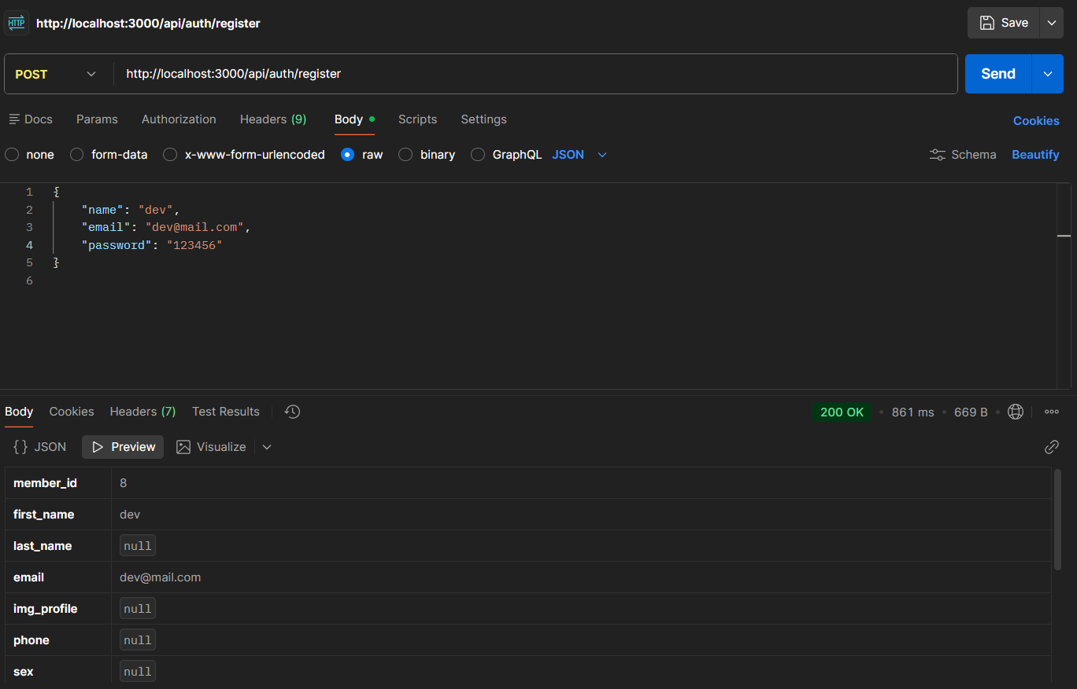
1. Register MEMber

Slide 3
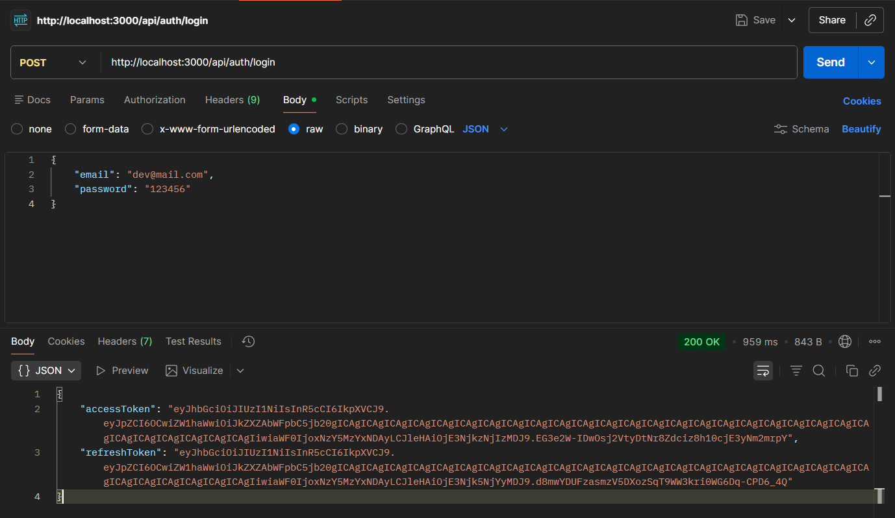
2. Auth login

Slide 4
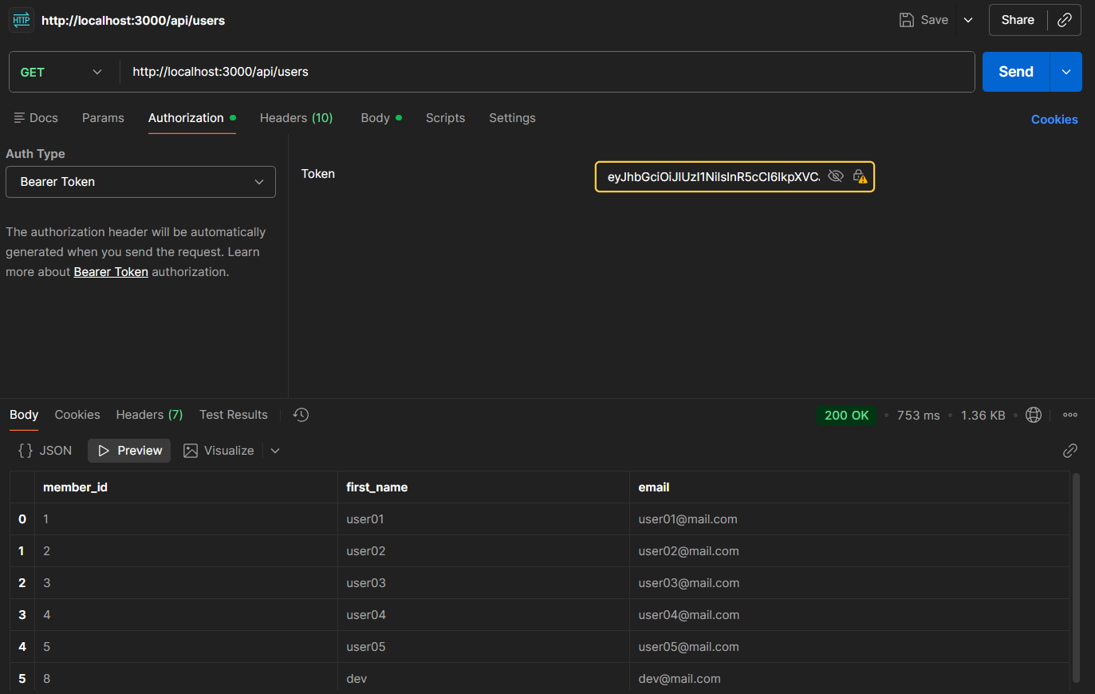
3. USE accessToken GET DATA

Slide 5
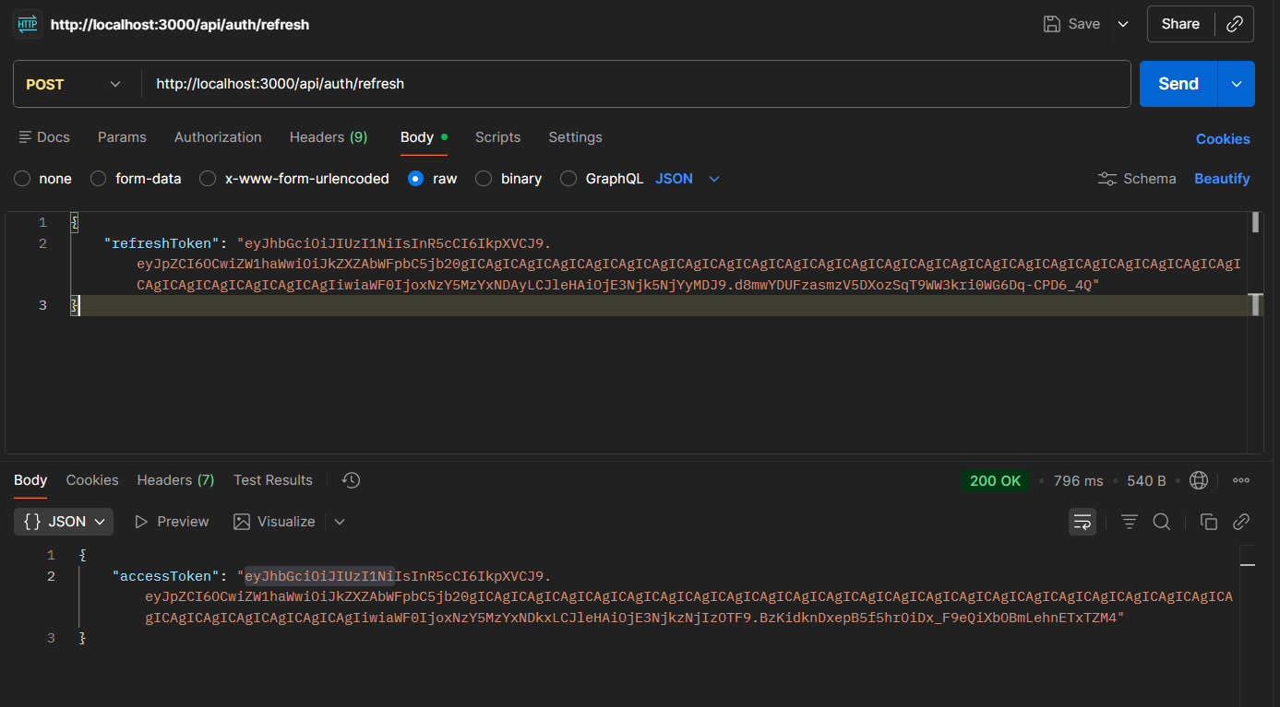
4. Renew accesstoken by refreshtoken

Slide 6
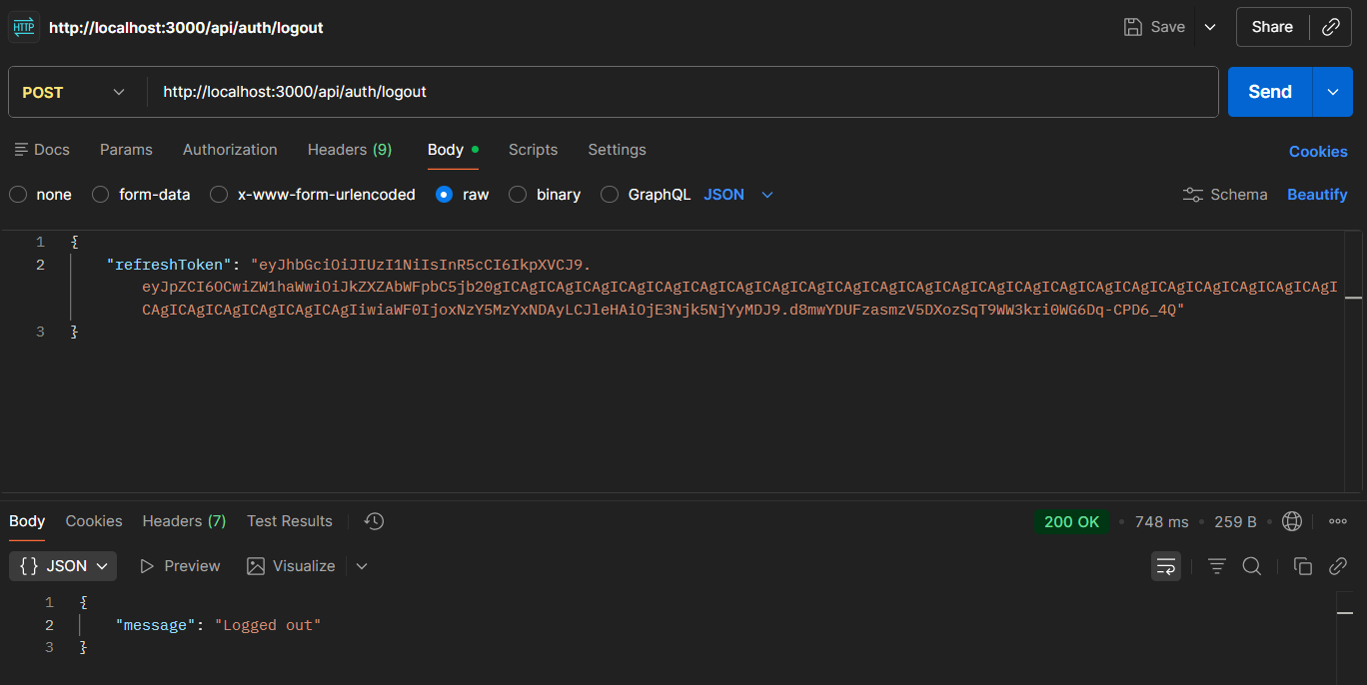
5. Logout by refreshtoken

